Slide 1

Is the health outcome of people living in rural counties different from those in urban counties in Texas?
Shane Livingston | Kip Madden
Tosh Murchison | Cenez Tindoc

Slide 2

HYPOTHESIS
Urban counties have a better health outcome than rural counties in Texas.

Slide 3
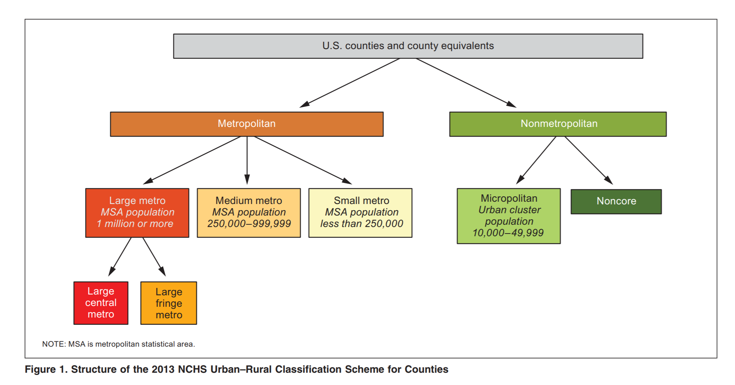

Urban/ rural → urcs
URCS

Slide 4



Data set
County Health Rankings

Slide 5

Research Questions to Answer
Do urban counties have a better age-adjusted mortality rate (AAMR) than rural counties?
What factors correlate with AAMR?
health behavior
clinical care
social and economic
physical environment
What are the five top and bottom counties measured by AAMR?

Slide 6
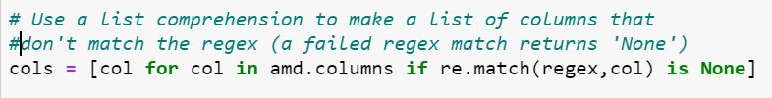
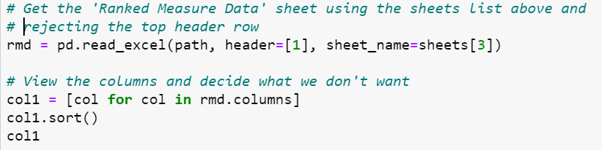
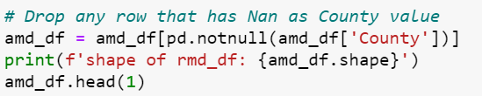


Data cleaning
Create a list of only wanted columns to be used for the usecols argument
Set FIPS to be the index
Eliminate any row without a county name
Make a list of available columns to decide what we don't want
Formulate a regex expression to match unwanted columns

Slide 7
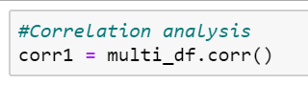

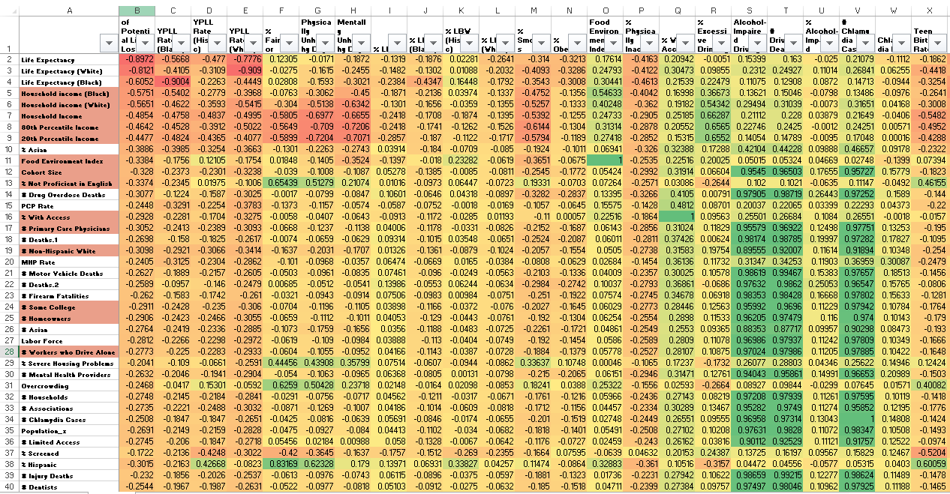
Correlation analysis
Run the CORR function with 156 factors
Sort on chosen dependent variable
Use color coding to eliminate non-independent variables
Grab the upper and bottom 10 factors
Used to calculate the correlation coefficient so we can focus on the most correlated factors

Slide 8
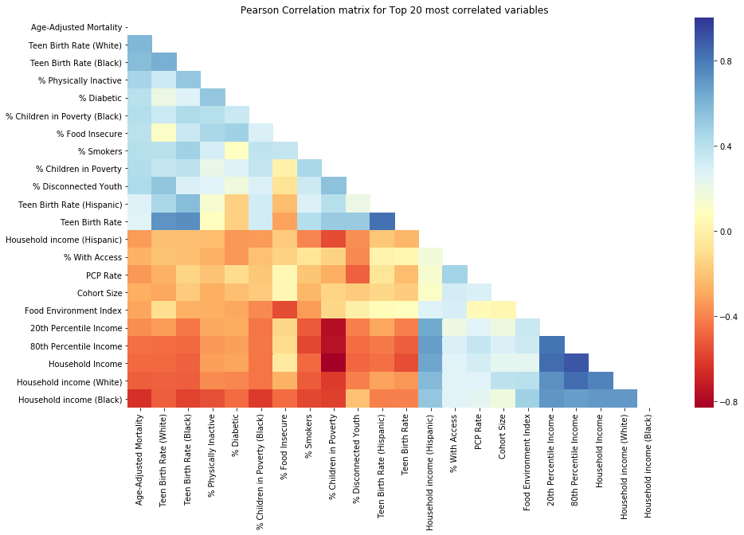
Correlation analysis

Slide 9
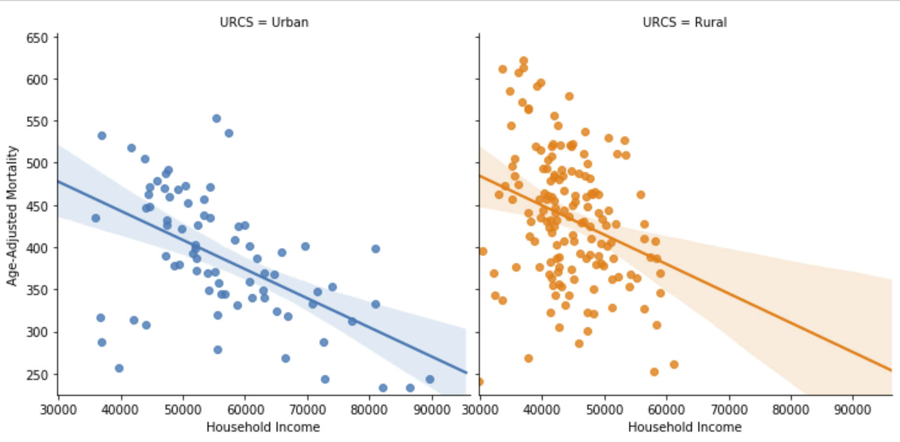
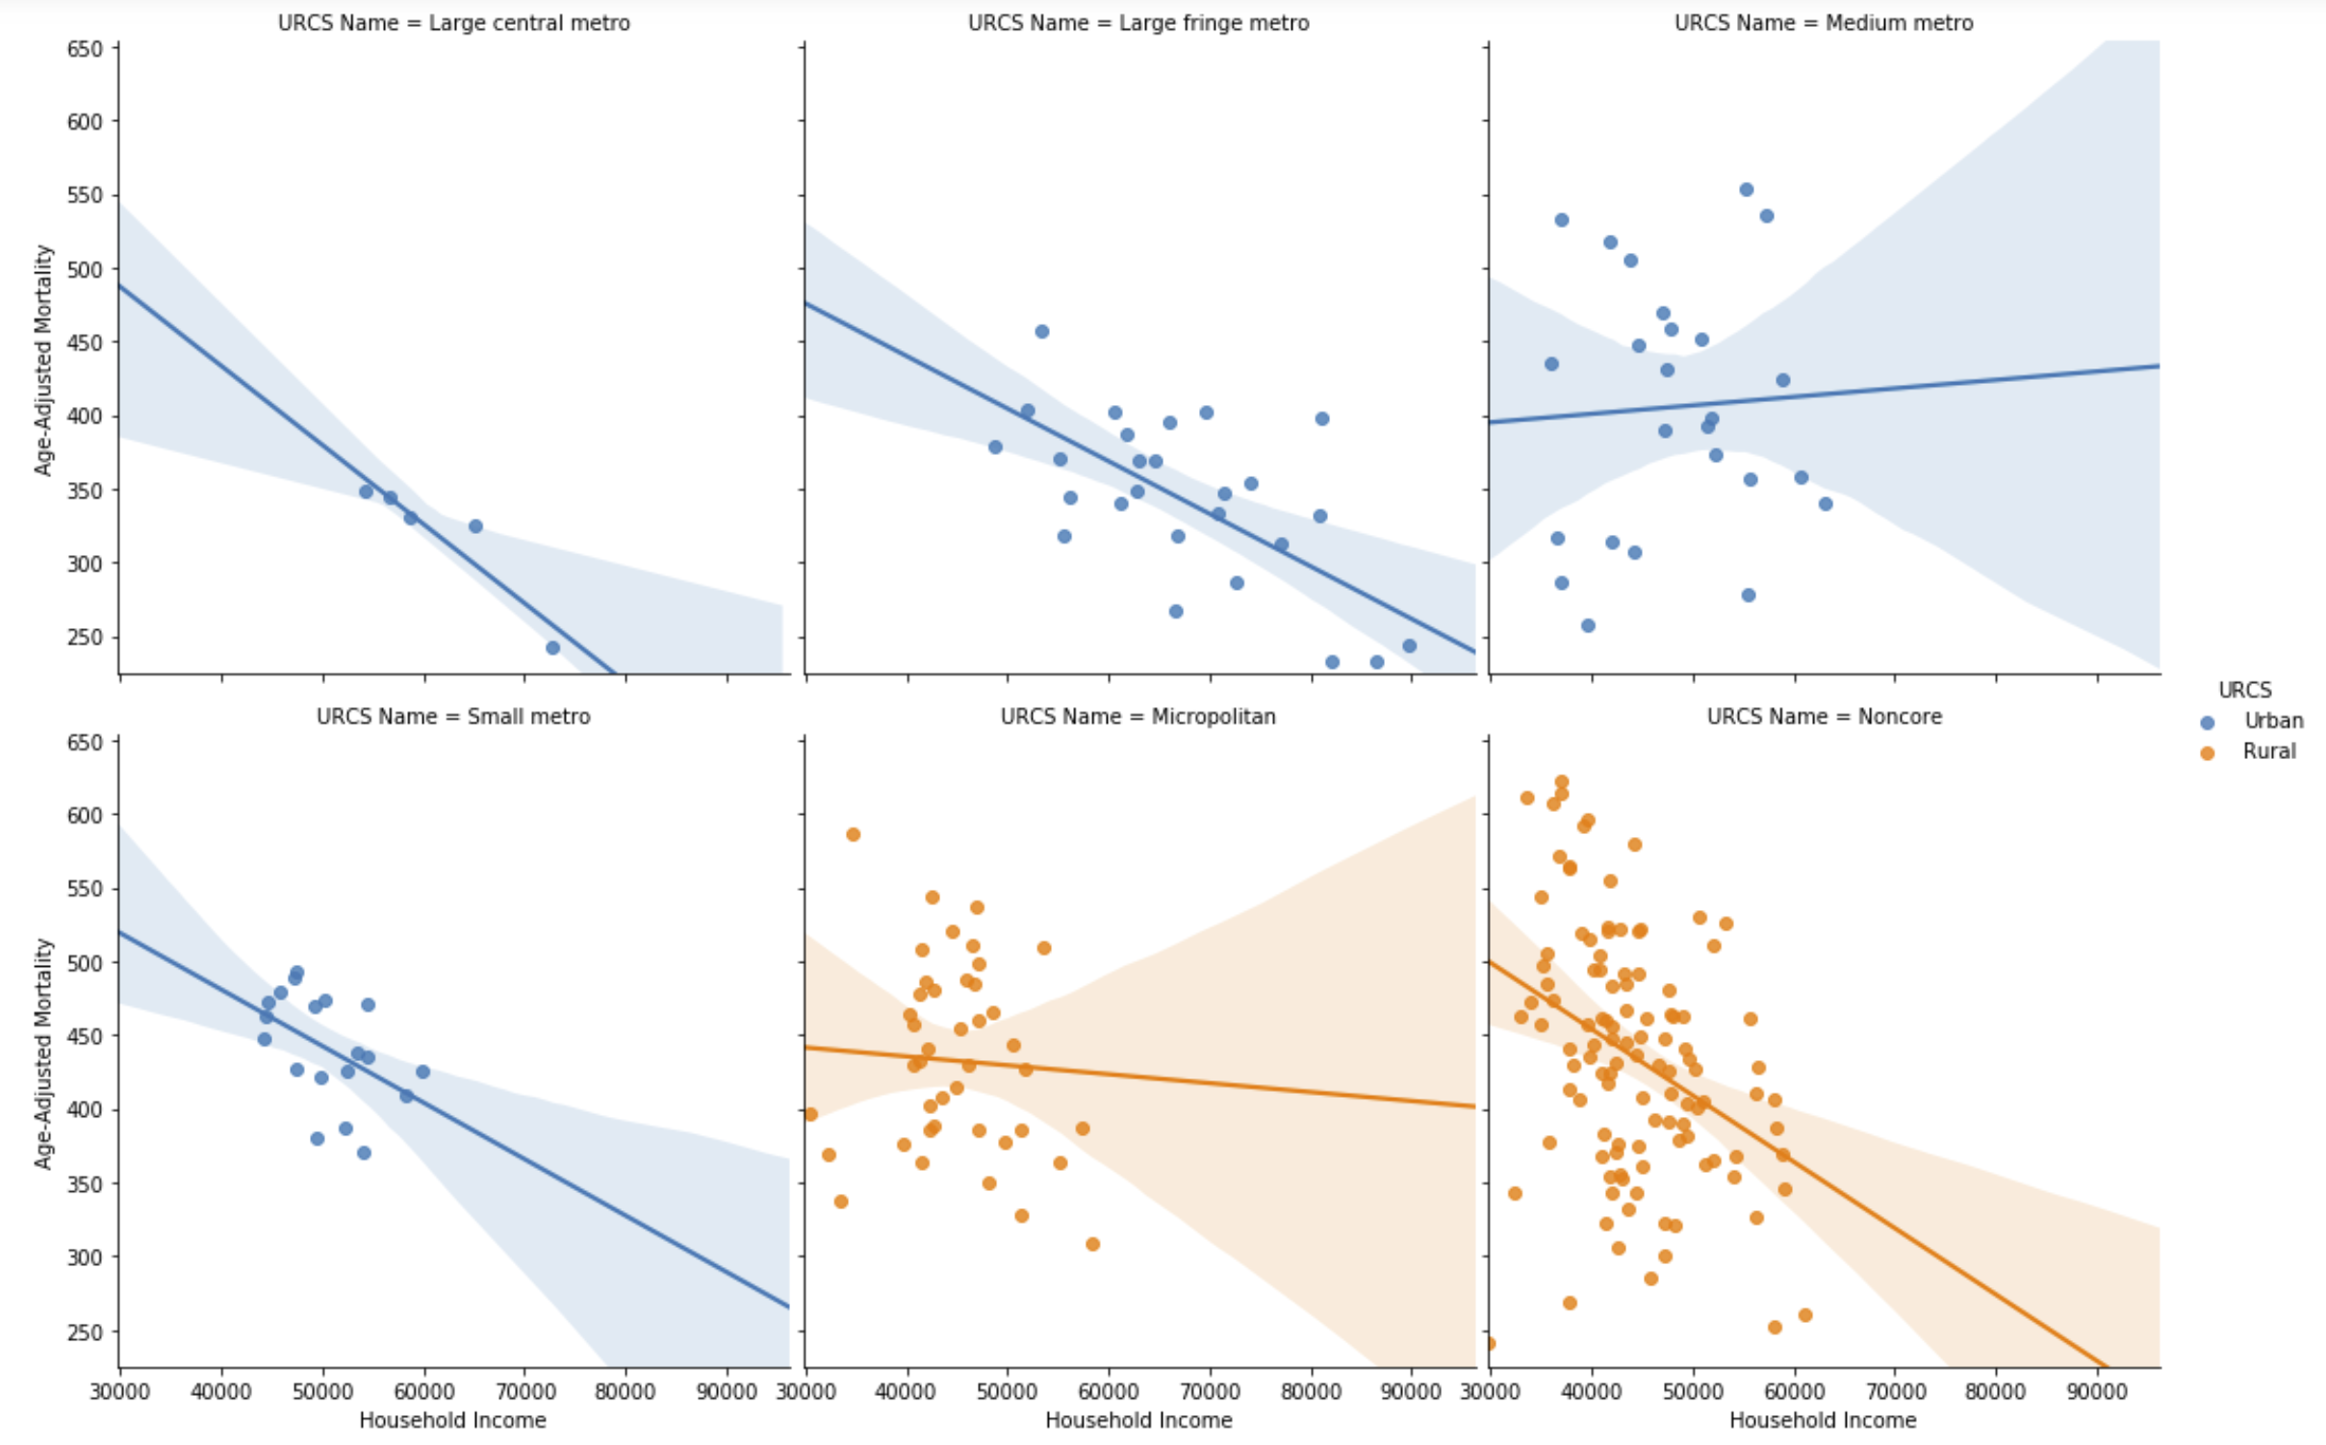
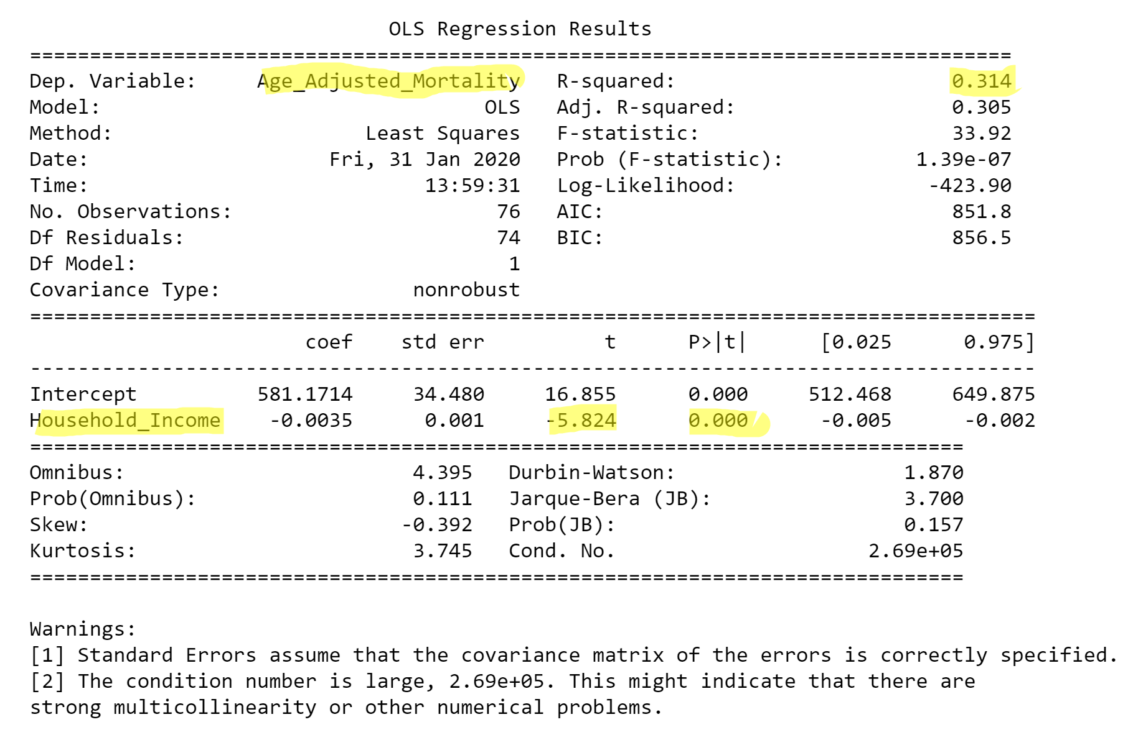
Analysis path
URBAN/ RURAL
If Urban/Rural looked interesting, we ran that parameter against the URCS classification split
Upper and bottom 10 factors from focused correlation matrix were runt through simple Urban/Rural
URCS
If a scatterplot looked interesting using URCS we did some linear regression on the parameter

Slide 10

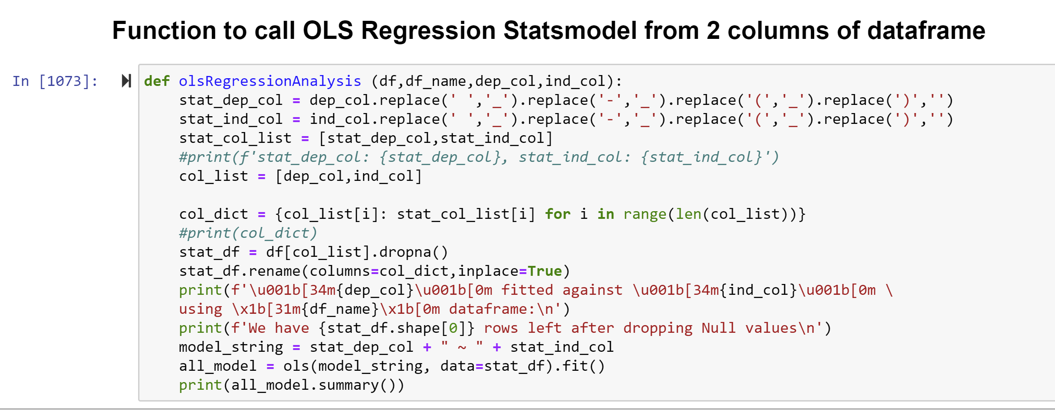
regression analysis

Slide 11

regression analysis
Age Adjusted Mortality
vs
Household
Income

Slide 12
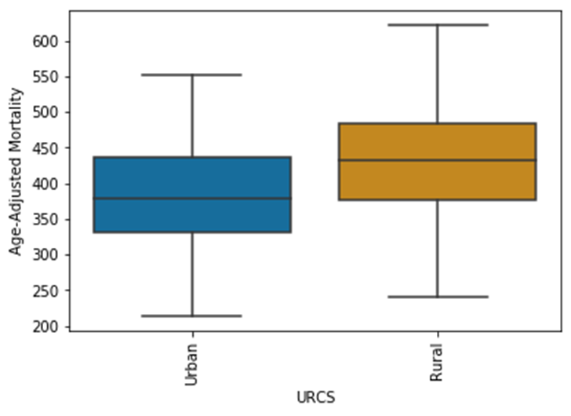
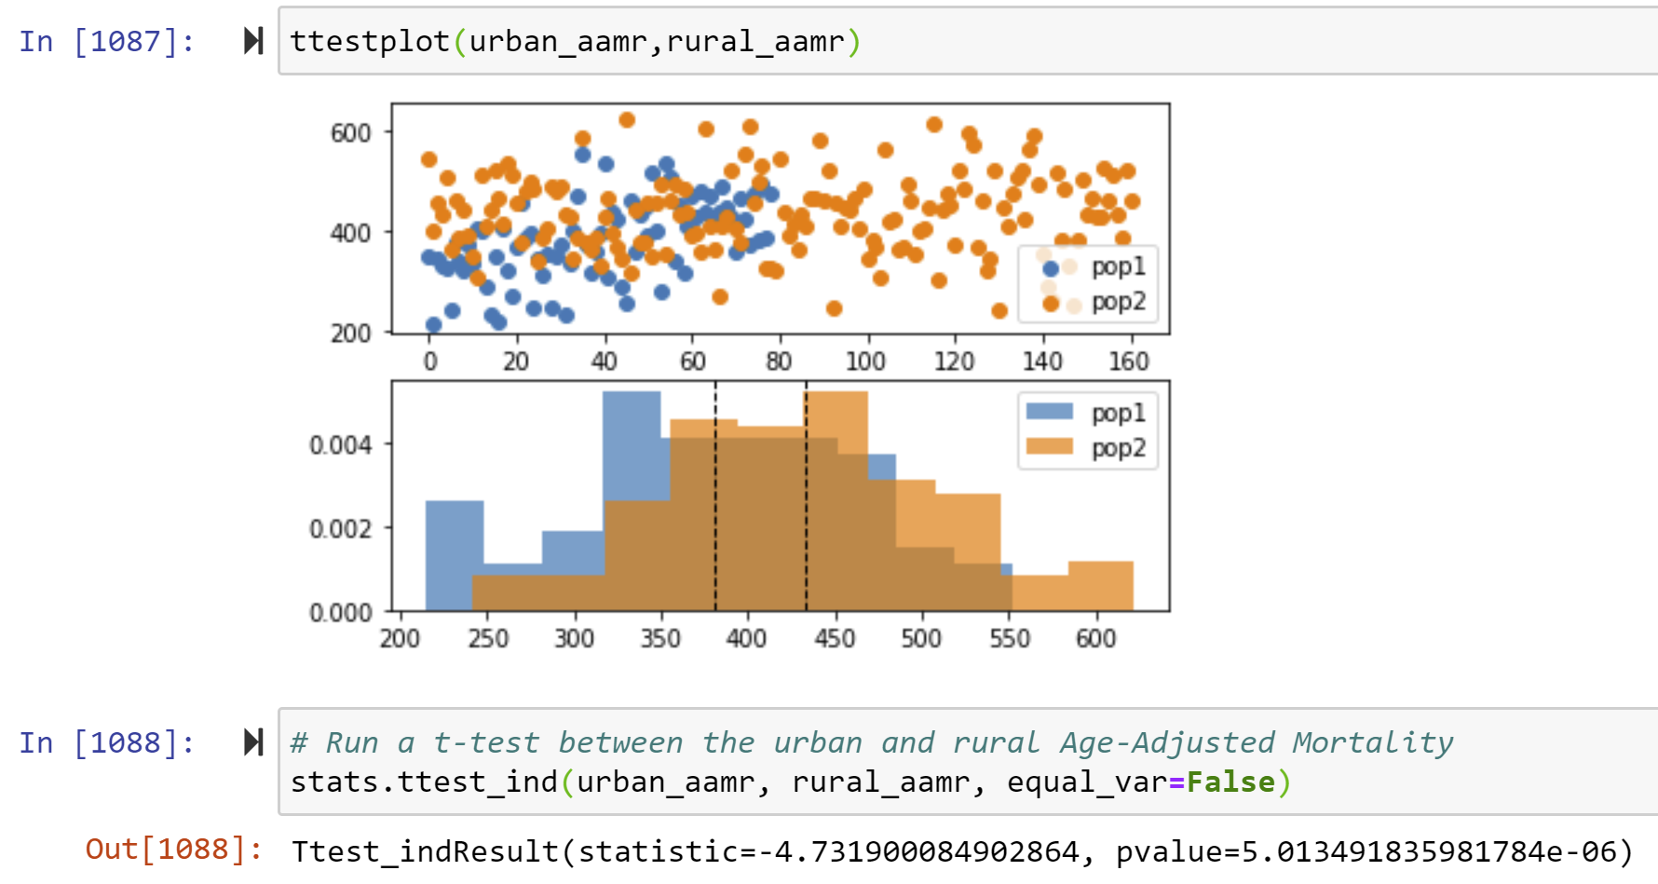
We reject our null-hypothesis for URBAN-RURAL ONLY CLASSIFICATION
AAMR – deaths/100k pop
t-test
There is a strong statistical difference to health outcome
as measured by Age-Adjusted Mortality Rate
(Deaths of under age 75 per 100,000 population)
between urban and rural county residents in Texas.
pvalue = 5.013e-06

Slide 13
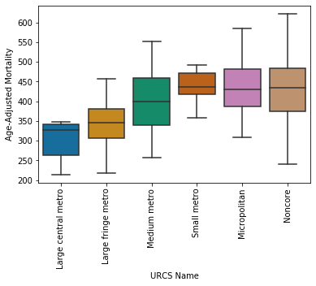
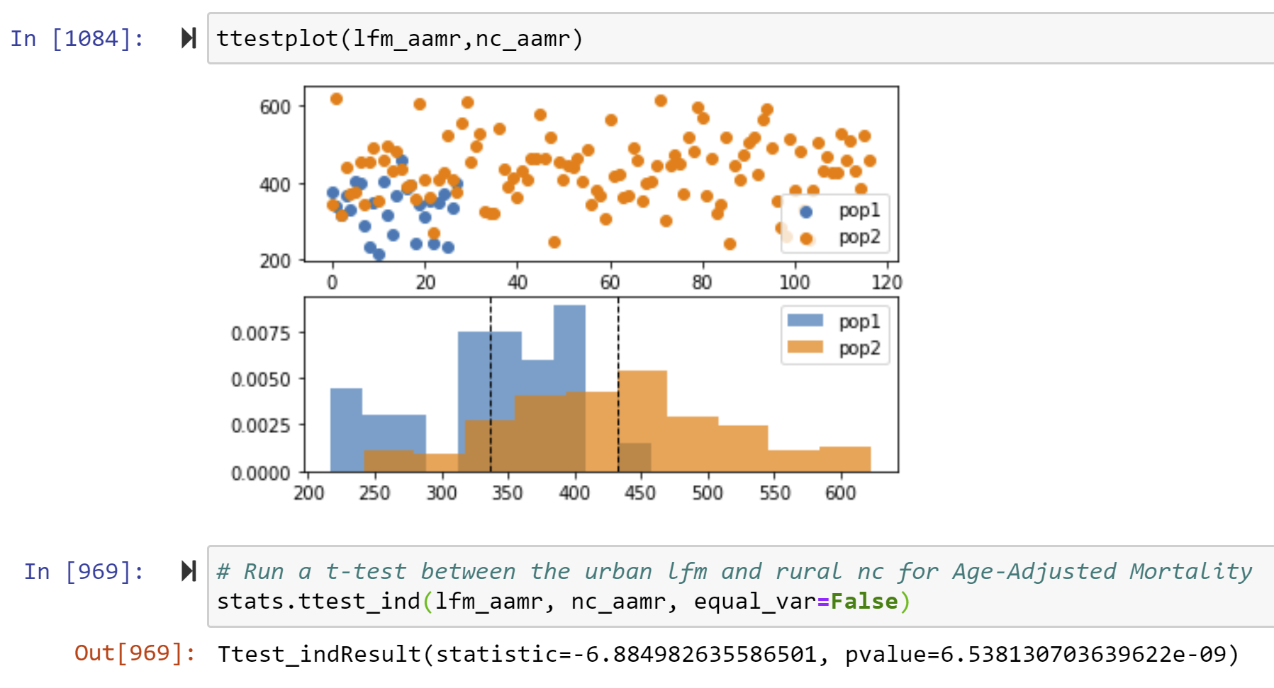
We reject our null-hypothesis FOR URCS CLASSIFIED LARGE METRO AREAS
Urban
Rural
t-test
pvalue = 6.5381e-09

Slide 14
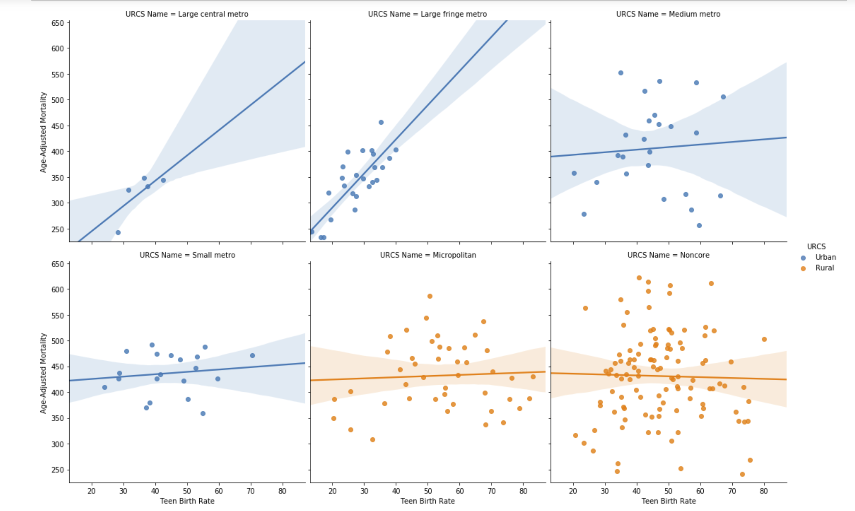
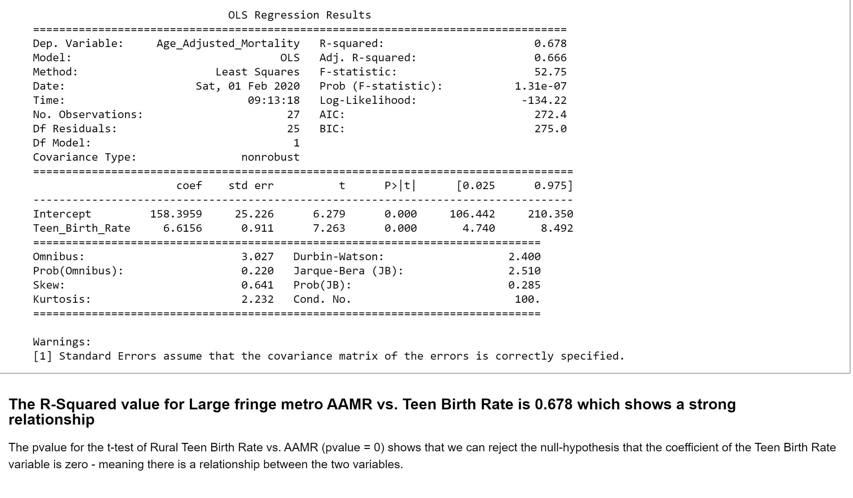
What factors correlate with AAMR?
Large fringe metro (Suburbs)
R-squared 0.678
AAMR (dead/100k)
Urban color
Rural color
Teen Birth Rate %

Slide 15
Summary – FACTORS CORRELATE W/ AAMR
COMPARATIVE ANALYSIS | BETTER OUTCOME
Age-adjusted Mortality Rate vs. Household Income | Urban
Age adjusted Mortality (Deaths/100k) for Diabetics | Urban
Age adjusted Mortality (Deaths/100k) for Smokers | Urban
Age adjusted Mortality (Deaths/100k) for Physically Inactive | Urban
Age adjusted Mortality (Deaths/100k) for Food Insecurity | Tie
Age adjusted Mortality (Deaths/100k) for Children in Poverty | Urban
Age adjusted Mortality (Deaths/100k) for Teen Birth Rate | Urban

Slide 16
What are the five top and bottom counties measured by AAMR?
TOP FIVE | BOTTOM FIVE
1. Collin | 1. Baylor
2. Fort Bend | 2. Marion
3. Denton | 3. Duval
4. Williamson | 4. Cottle
5. Presidio | 5. Morris

Slide 17

conclusion
HYPOTHESIS
Urban counties have a better health outcome than rural counties in Texas.
RESULT
We can reject the (null) hypothesis that Texas urban county health outcomes are not statistically better than rural counties.

